Slide 1
CREDO Customizable, REproducible, DOcker file generator for bioinformatics applications
Eliseo Martelli
Università degli Studi di Torino

Slide 2
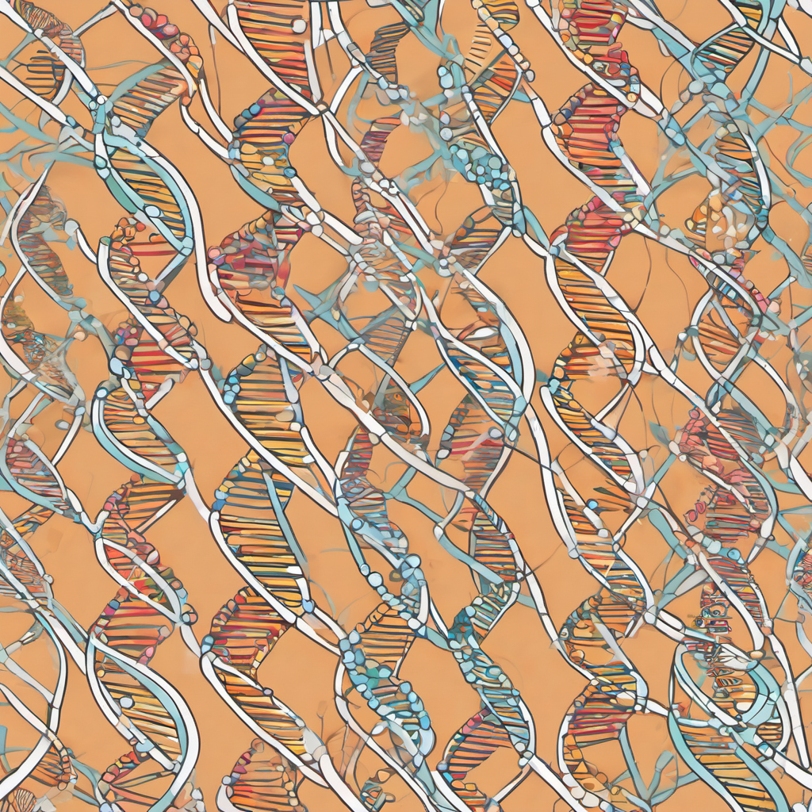
Bioinformatics is a discipline
that intersects various
fields of research.

Slide 3
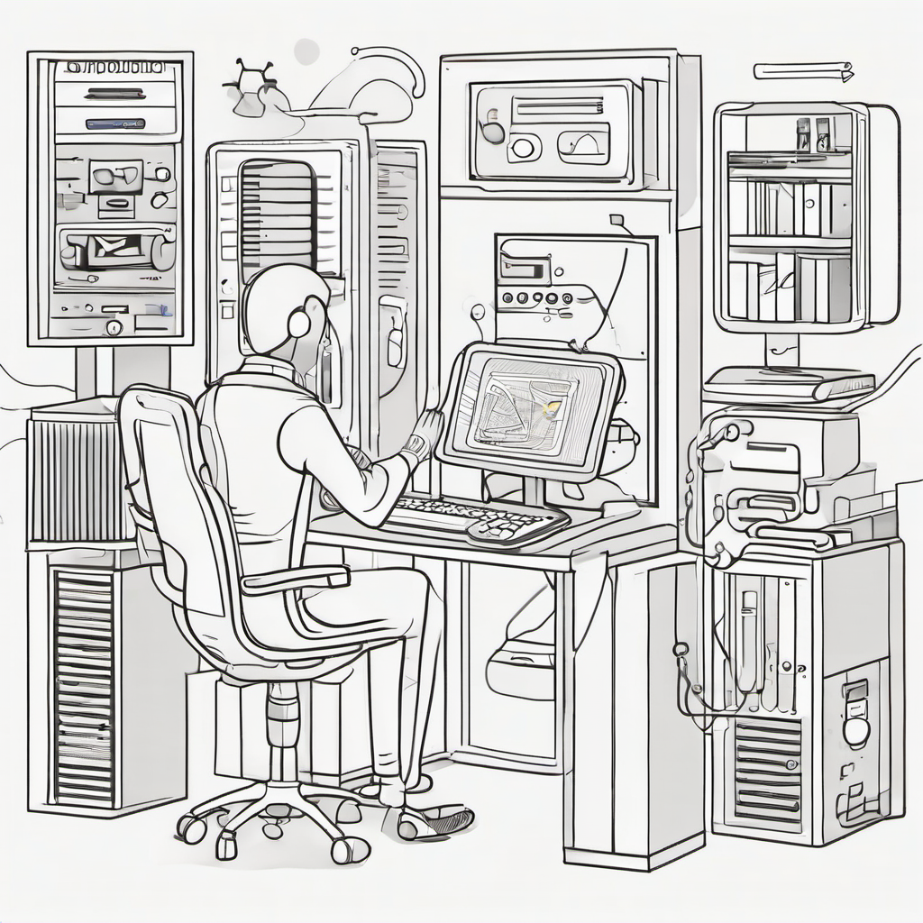
Bioinformatics is a discipline
that intersects various
fields of research.
Biology
Computer Science
Statistics

Slide 4
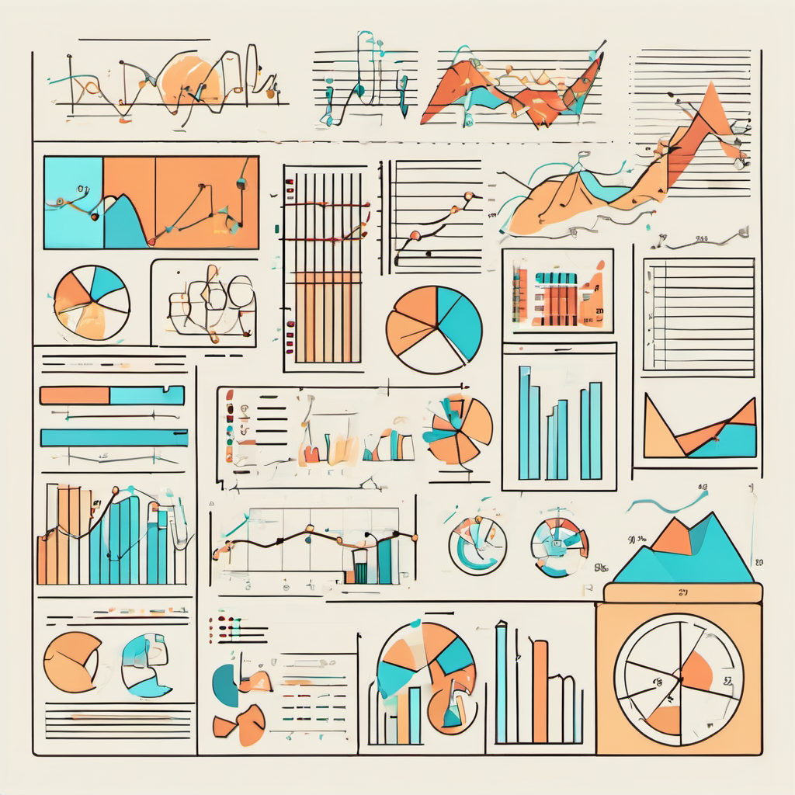
Bioinformatics is a discipline
that intersects various
fields of research.
Biology
Computer Science
Statistics

Slide 5
Bioinformatics is a discipline
that intersects various
fields of research.
Biology
Computer Science
Statistics

Slide 6
PROBLEM
Bioinformatics is a discipline
that intersects various
fields of research.
Experiment Reproducibility
is hard in Bioinformatics.

Slide 7
PROBLEM
Experiment Reproducibility
is hard in Bioinformatics.
Let’s compare 2 software versions
blast 2.12.0, build Mar 8 2022 16:19:08
blast 2.2.31, build Jun 2 2015 10:47:46

Slide 8
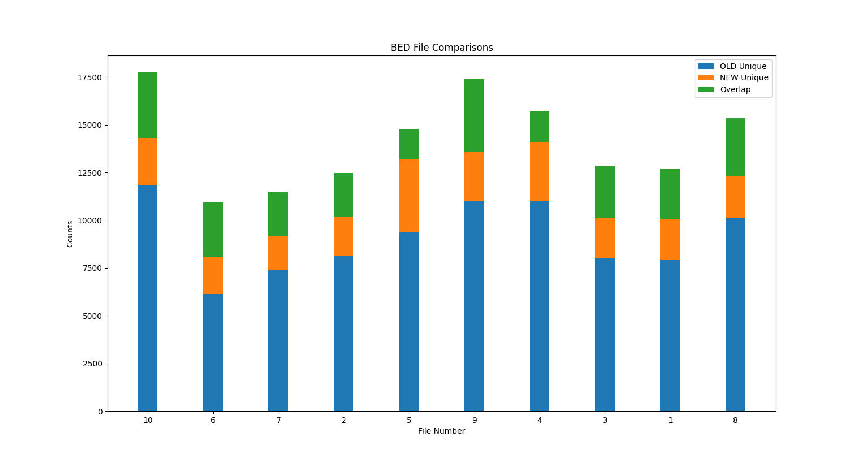
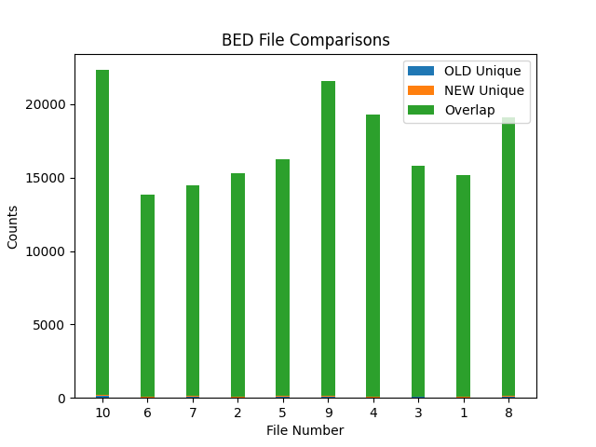
PROBLEM
Experiment Reproducibility
is hard in Bioinformatics.
Let’s compare 2 software versions
blast 2.12.0, build Mar 8 2022 16:19:08
blast 2.2.31, build Jun 2 2015 10:47:46

Slide 9
PROBLEM
Experiment Reproducibility
is hard in Bioinformatics.
Validity & Reliability
Insufficient Documentation
Lack of Standardization

Slide 10
PROBLEM
Experiment Reproducibility
is hard in Bioinformatics.
Validity & Reliability
Insufficient Documentation
Lack of Standardization

Slide 11
PROBLEM
Experiment Reproducibility
is hard in Bioinformatics.
Validity & Reliability
Insufficient Documentation
Lack of Standardization

Slide 12
F
A
R
I
CREDO stands
by the
principles.

Slide 13
I
F
FINDABILITY
Consolidation of sources for researchers
to access, install, and utilize the software using centralized platforms.
A
R

Slide 14
F
A
ACCESSIBILITY
Simplification of the process of creating reproducible environments to users without previous bioinformatics knowledge.
I

Slide 15
A
I
INTEROPERABILITY
Ensuring compatible with the most widely available operating systems to maximize the range of users that can use the application.
R

Slide 16
I
R
REUSABILITY
Facilitation of software customization.
Ensure archival of dependencies to prevent future inaccessibility of dependencies.

Slide 17



A possible solution?
Containerization.

Slide 18
But…
Containerization.
doesn’t solve one big problem:
Dependency Management

Slide 19
Dependency Management
Involves efficiently handling and controlling the software components and libraries needed for an application to function properly, ensuring compatibility and mitigating conflicts.

Slide 20
PLAN
Modularity & Optimization
Achieved through code-refactoring and implementing strong architectural patterns.

Slide 21
PLAN
PLAN
Modularity & Optimization
Achieved through code-refactoring and implementing strong architectural patterns.
UI Redesign
Improve UI design and performance to increase user interaction quality and speed.

Slide 22
PLAN
Modularity & Optimization
Achieved through code-refactoring and implementing strong architectural patterns.
PLAN
UI Redesign
Improve UI design and performance to increase user interaction quality and speed.
Multiuser Environment
Restructure the application to support multiple users and permissions.

Slide 23
UI Redesign
Improve UI design and performance to increase user interaction quality and speed.
PLAN
Multiuser Environment
Restructure the application to support multiple users and permissions.
DOI Tagging
Assign DOI references to artifacts generated
to facilitate citations and references.

Slide 24
Multiuser Environment
Restructure the application to support multiple users and permissions.
PLAN
DOI Tagging
Assign DOI references to artifacts generated
to facilitate citations and references.
Quality Assurance & Testing
Configure safeguards and robust testing
methodologies via CI and GitOps.

Slide 25
DOI Tagging
Assign DOI references to artifacts generated
to facilitate citations and references.
PLAN
Quality Assurance & Testing
Configure safeguards and robust testing
methodologies via CI and GitOps.
Documentation
Produce In-depth documentation
by following a doc-first approach.

Slide 26
Quality Assurance & Testing
Configure safeguards and robust testing
methodologies via CI and GitOps.
PLAN
Documentation
Produce In-depth documentation
by following a doc-first approach.

Slide 27

Documentation
Produce In-depth documentation
by following a doc-first approach.
PLAN
We Open Source

Slide 28
We Open Source
OSS Contributions
Using industry standard libraries
Building tools for the community

Slide 29
We Open Source
OSS Contributions
Using industry standard libraries
Building tools for the community

Slide 30
We Open Source
OSS Contributions
Using industry standard libraries
Building tools for the community

Slide 31
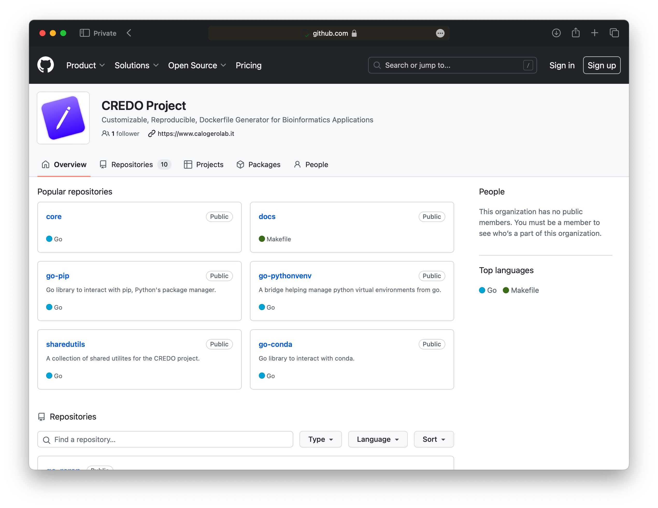

We Open Source
Github.com/CREDOProject

Slide 32






Modular Architecture
We Open Source
Golang
NEW
A new evolution of CREDO.
Built from the ground up.
Github.com/CREDOProject
Goroutines
Channels
WaitGroups
Idempotence
Registry
Pattern

Slide 33
NEW
A new evolution of CREDO.
Built from the ground up.
Modular Architecture
Golang
Goroutines
Channels
WaitGroups
Idempotence
Registry
Pattern

Slide 34
NEW
A new evolution of CREDO.
Built from the ground up.
Modular Architecture
Golang
Goroutines
Channels
WaitGroups
Idempotence
Registry
Pattern

Slide 35
NEW
A new evolution of CREDO.
Built from the ground up.
Modular Architecture
Golang
Goroutines
Channels
WaitGroups
Idempotence
Registry
Pattern

Slide 36
NEW
A new evolution of CREDO.
Built from the ground up.
Modular Architecture
Golang
Goroutines
Channels
WaitGroups
Idempotence
Registry
Pattern

Slide 37
NEW
A new evolution of CREDO.
Built from the ground up.
Modular Architecture
Golang
Goroutines
Channels
WaitGroups
Idempotence
Registry
Pattern

Slide 38
ARCHITECTURE
CREDO’s new building blocks.

Slide 39
ARCHITECTURE
FILEs
APT
Config
Store
FILEs
Configuration
Provider
Running
Configuration
Modules
Configuration
Provider
PIP
Database
CRAN
Filesystem
Database
…

Slide 40
ARCHITECTURE
Where are we now?

Slide 41
0
1
2
3
4
5
6
7
8
+
ARCHITECTURE
Where are we now?
Open Source
Libraries Released

Slide 42
0
1
2
3
+
ARCHITECTURE
Where are we now?
Integrated Package Managers

Slide 43
Thank you!
credo@eliseomartelli.it

